Slide 1


Digital portfolio
NAME: S.DIVYADHARSHINI
REG NO: 2123403600
NMID:B88B5F94809FCE98F5A4B08860EB50E5
COLLEGE NAME: Mahalashmi
Women's college of arts and science
University : University of Madras
Department: BCA

Slide 2
Project title
01
Student portfolio - web development by
S . Divyadharshini

Slide 3
AGENDA
Problem statement
Project overview
End users
Tools and technologies
Portfolio design and layout
Features and functionality
Results and screenshot
Conculsion
Githup link

Slide 4
Problem statement
In today’s digital world, students need a professional online presence to showcase their skills, projects, and achievements. Traditional resumes are often limited in demonstrating creativity, technical ability, and personality. Without a well-structured portfolio website, it becomes challenging for students to stand out in academic opportunities, internships, and job applications.

Slide 5
Project overview
The Student Portfolio Website is a personal web-based application designed to showcase an individual’s skills, projects, and achievements in a professional manner. It acts as a digital resume and an online identity for students aspiring to enter the tech field.
02

Slide 6
Who are the user?
1. Primary User (Owner / Student)
The student who creates the portfolio.
Uses the website to showcase personal information, skills, projects, and achievements.
2. Secondary Users (Visitors)
Recruiters / Hiring Managers → to evaluate the student’s skills and suitability for jobs or internships.

Slide 7
Tools and technologies⚙️🔎
1. Frontend Technologies
HTML5 → for structuring the content of the website.
CSS3 → for styling, layout design, responsiveness, and visual appeal.
JavaScript (Vanilla JS) → for interactivity (menu toggle, form handling, etc.).

Slide 8
2. Development Tools
Code Editor: VS Code / Sublime Text / Atom (for writing and editing code).
Browser: Google Chrome / Firefox / Edge (for testing and debugging).
CodePen / JSFiddle / GitHub Pages (optional) → for hosting, showcasing, and sharing the project.

Slide 9

Portfolio design and layout📌
1. Overall Design Approach Theme: Clean, modern, and minimal with a focus on readability. Colors: Combination of light backgrounds with contrasting highlight colors (e.g., orange & black). Typography: Clear sans-serif fonts for better readability.

Slide 10

2. Layout Sections 🔹 Header / Navigation Bar Fixed at the top for easy access. Contains logo/name on the left and navigation links on the right. On smaller screens, links collapse into a hamburger menu.
Enter title

Slide 11
Features and functionality🪶
🔹 1. Navigation
Fixed navigation bar for quick access to different sections.
🔹 2. Hero Section
Displays the student’s name, role (e.g., “Aspiring Web Developer”), and a call-to-action button (“View My Work

Slide 12
Result and screenshot 📌
The Student Portfolio Website was successfully developed using HTML, CSS, and JavaScript. The final website is responsive, interactive, and user-friendly, allowing smooth navigation across different devices such as desktops, tablets, and mobile phones.

Slide 13
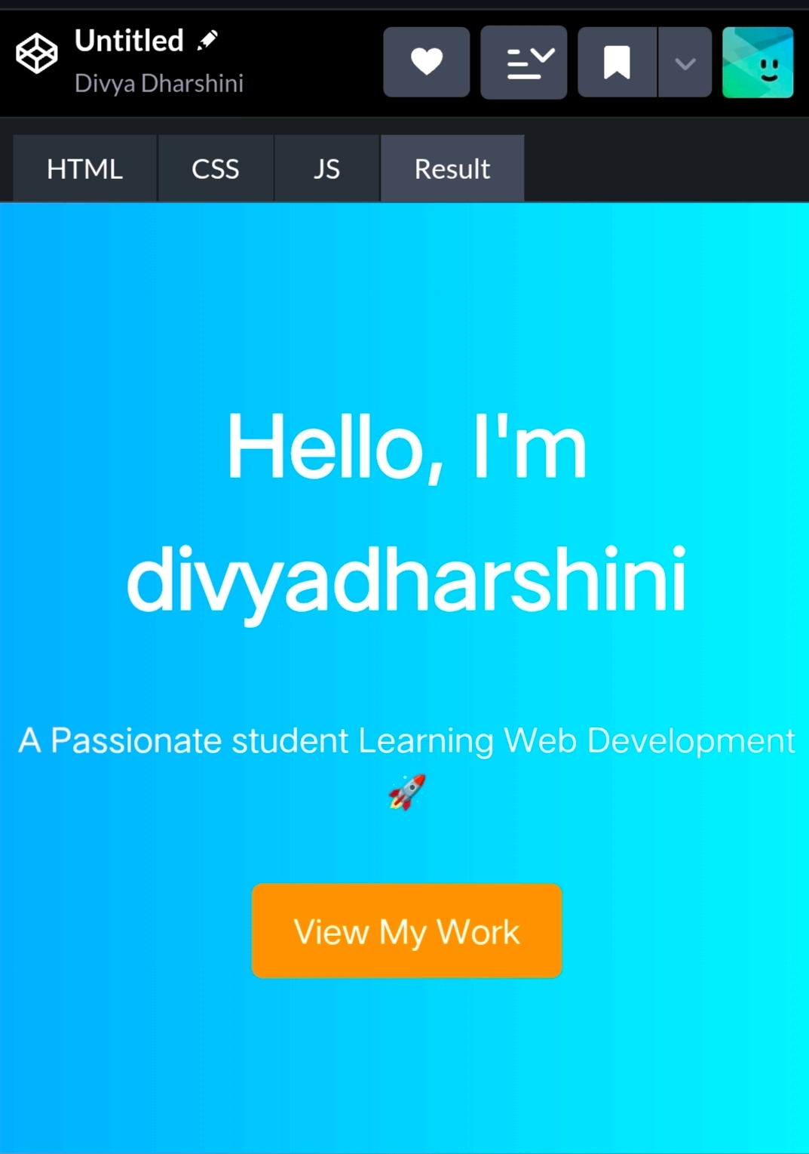
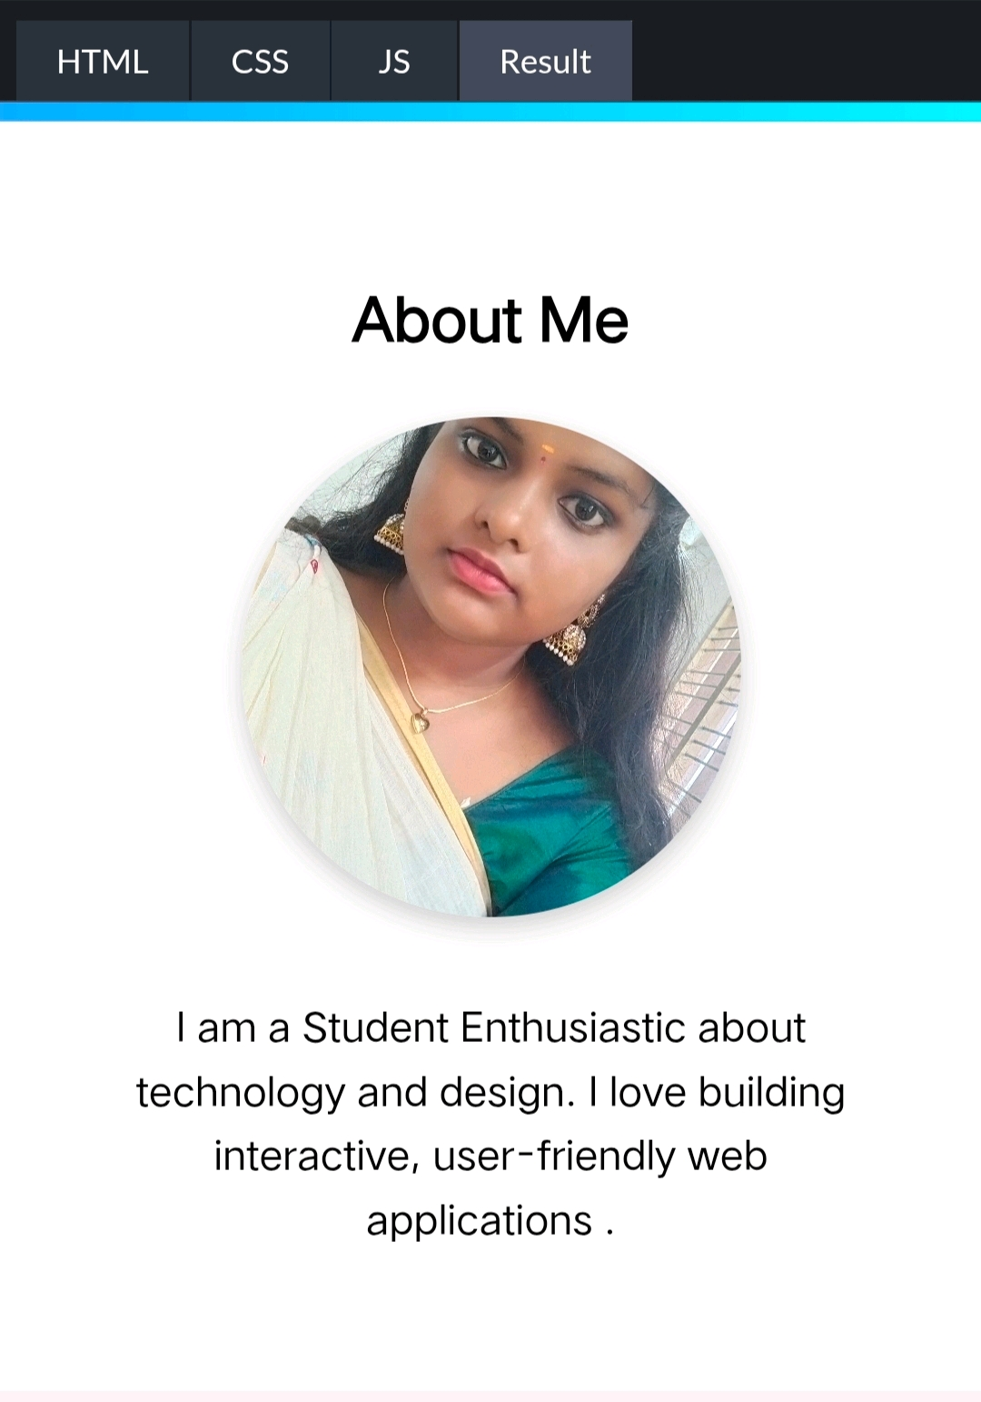
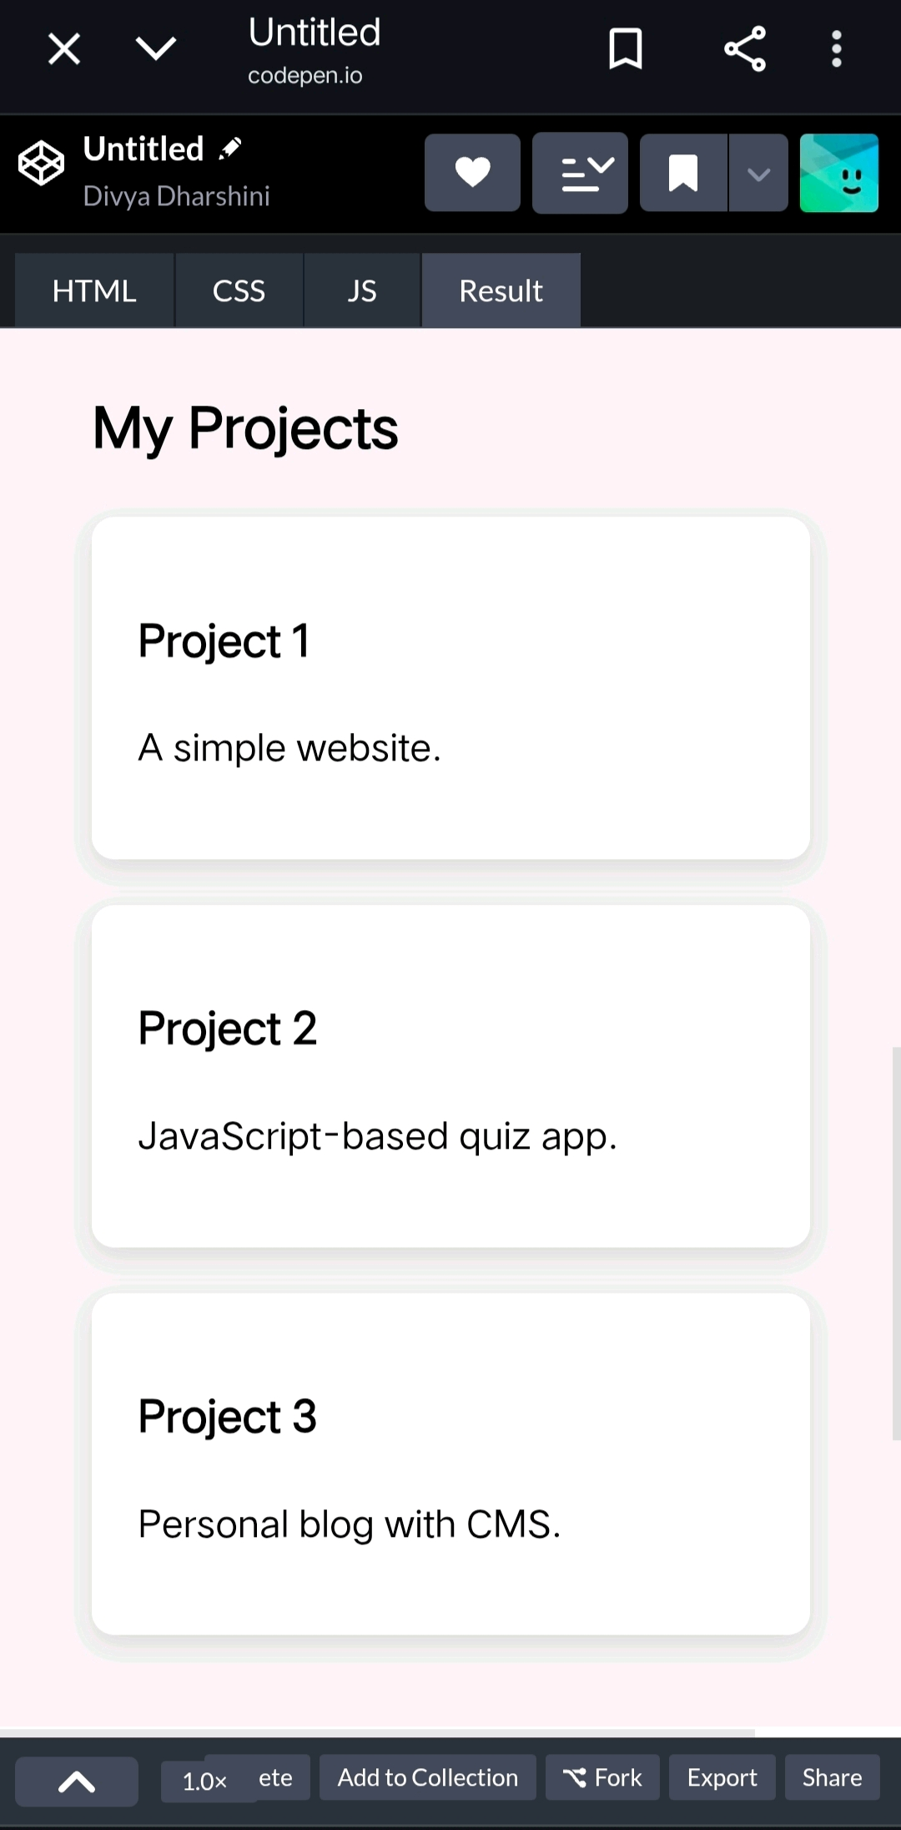
Screenshot📱📸

Slide 14
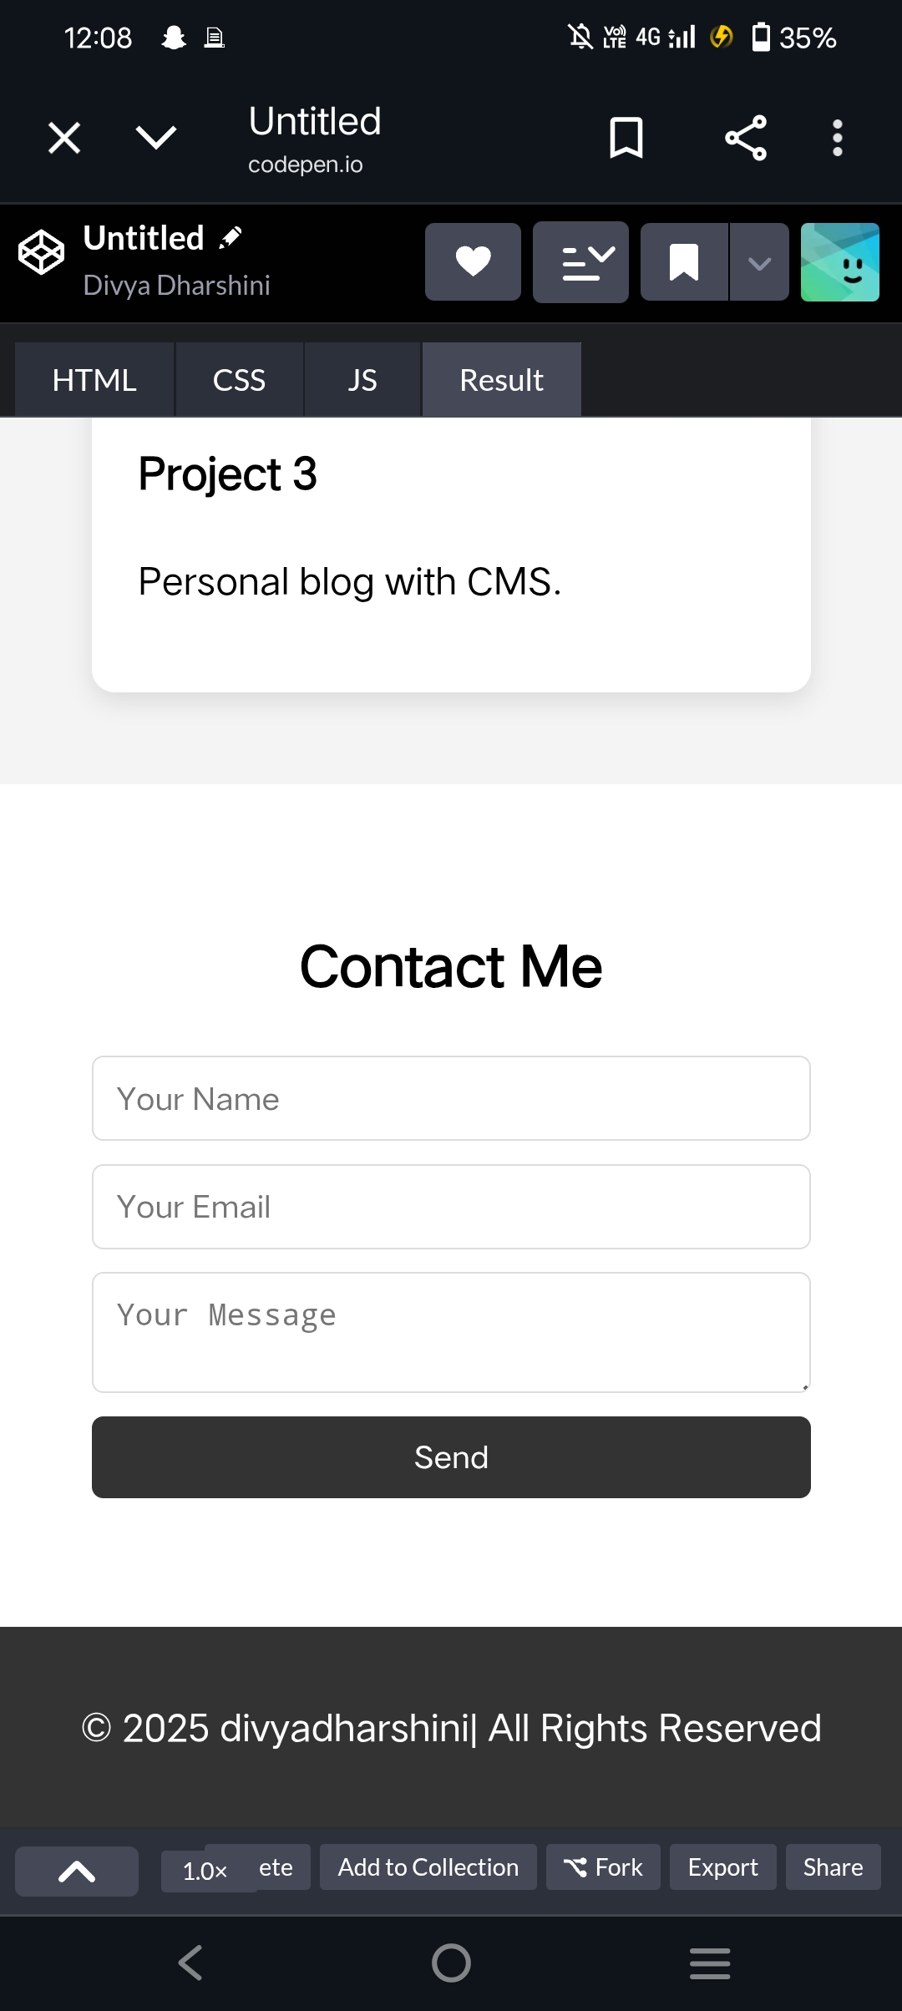
Result screenshot📸

Slide 15
Conclusion ⚙️⚙️⚙️
The development of the Student Portfolio Website successfully achieved its goal of creating a responsive, interactive, and user-friendly platform for students to showcase their skills, projects, and achievements. By using HTML, CSS, and JavaScript, the project highlights the ability to design and implement a structured and visually appealing website.

